Slide 1

CSE- 4105
Lecture-13
Clipping-II

Slide 2
Clipping Polygons
We know how to clip a single line segment
How about a polygon in 2D?
How about in 3D?
Clipping polygons is more complex than clipping the individual lines
Input: polygon
Output: polygon, or nothing

Slide 3
Why Is Clipping Hard?
What happens to a triangle during clipping?
Possible outcomes:
Triangle🡪triangle
Triangle🡪quad
Triangle🡪5-gon
How many sides can a clipped triangle have?

Slide 4
Why Is Clipping Hard?
A really tough case:

Slide 5
Why Is Clipping Hard?
A really tough case:
concave polygon🡪multiple polygons

Slide 6
Sutherland-Hodgman Clipping
Basic idea:
Consider each edge of the viewport individually
Clip the polygon against the edge equation
After doing all planes, the polygon is fully clipped

Slide 7
Sutherland-Hodgman Clipping
Basic idea:
Consider each edge of the viewport individually
Clip the polygon against the edge equation
After doing all planes, the polygon is fully clipped

Slide 8
Sutherland-Hodgman Clipping
Basic idea:
Consider each edge of the viewport individually
Clip the polygon against the edge equation
After doing all planes, the polygon is fully clipped

Slide 9
Sutherland-Hodgman Clipping
Basic idea:
Consider each edge of the viewport individually
Clip the polygon against the edge equation
After doing all planes, the polygon is fully clipped

Slide 10
Sutherland-Hodgman Clipping
Basic idea:
Consider each edge of the viewport individually
Clip the polygon against the edge equation
After doing all planes, the polygon is fully clipped

Slide 11
Sutherland-Hodgman Clipping
Basic idea:
Consider each edge of the viewport individually
Clip the polygon against the edge equation
After doing all planes, the polygon is fully clipped

Slide 12
Sutherland-Hodgman Clipping
Basic idea:
Consider each edge of the viewport individually
Clip the polygon against the edge equation
After doing all planes, the polygon is fully clipped

Slide 13
Sutherland-Hodgman Clipping
Basic idea:
Consider each edge of the viewport individually
Clip the polygon against the edge equation
After doing all planes, the polygon is fully clipped

Slide 14
Sutherland-Hodgman Clipping
Basic idea:
Consider each edge of the viewport individually
Clip the polygon against the edge equation
After doing all planes, the polygon is fully clipped

Slide 15
Sutherland-Hodgman Clipping
Basic idea:
Consider each edge of the viewport individually
Clip the polygon against the edge equation
After doing all planes, the polygon is fully clipped

Slide 16
Sutherland-Hodgman Clipping
Input/output for algorithm:
Input: list of polygon vertices in order
Output: list of clipped polygon vertices consisting of old vertices (maybe) and new vertices (maybe)
Note: this is exactly what we expect from the clipping operation against each edge

Slide 17
Sutherland-Hodgman Clipping
Sutherland-Hodgman basic routine:
Go around polygon one vertex at a time
Current vertex has position p
Previous vertex had position s, and it has been added to the output if appropriate

Slide 18
Sutherland-Hodgman Clipping
Edge from s to p takes one of four cases:
(Gray line can be a line or a plane)
inside
outside
inside
outside
inside
outside
inside
outside
p
s
p
s
p
s
p
s
p output
i output
no output
i output p output

Slide 19
Sutherland-Hodgman Clipping
Four cases:
s inside plane and p inside plane
Add p to output
Note: s has already been added
s inside plane and p outside plane
Find intersection point i
Add i to output
s outside plane and p outside plane
Add nothing
s outside plane and p inside plane
Find intersection point i
Add i to output, followed by p

Slide 20
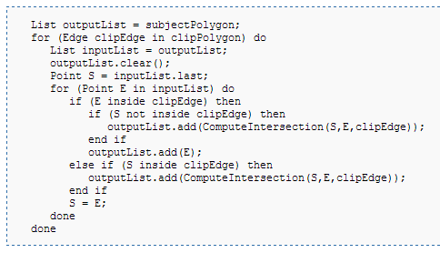
Sutherland-Hodgman Clipping
‹#›

Slide 21
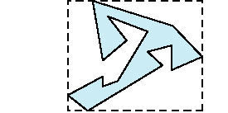
Bounding Boxes
Rather than doing clipping on a complex polygon, we can use an axis-aligned bounding box or extent
Smallest rectangle aligned with axes that encloses the polygon
Simple to compute: max and min of x and y
‹#›

Slide 22
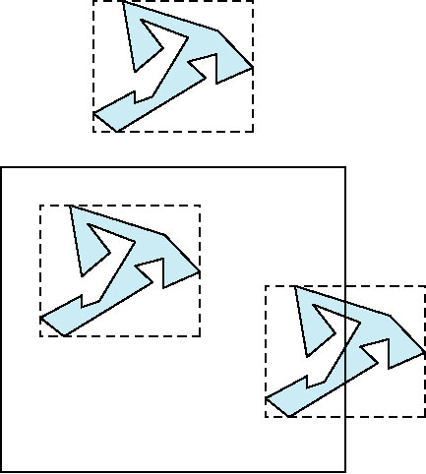
Bounding Boxes
Can usually determine accept/reject based only on bounding box
reject
accept
requires detailed
clipping
Ellipsoid collision detection
‹#›

Slide 23
Rasterization
Rasterization (scan conversion)
Determine which pixels that are inside primitive specified by a set of vertices
Produces a set of fragments
Fragments have a location (pixel location) and other attributes such color, depth and texture coordinates that are determined by interpolating values at vertices
Pixel colors determined later using color, texture, and other vertex properties.
‹#›

Slide 24
Sutherland-Hodgman Polygon Clipping
Efficient algorithm for clipping convex polygons.
Edges are clipped against every border line of clipping window. Edges are processed successively.
Allows pipelining of edge clipping of polygons, as well as pipelining of different polygons.
1
1’’
1’’
1’
3’’
1’
3’’
Clipping
Clipping Window
3
3’
3’
2’
2’’
2’
2’’
2

Slide 25
Sutherland-Hodgman Polygon Clipping
The four possible outputs generated by the left clipper, depending on the relative position of pair of edge endpoints.
inside
outside
s
p
p output

Slide 26
Sutherland-Hodgman Polygon Clipping
The four possible outputs generated by the left clipper, depending on the relative position of pair of edge endpoints.
inside
outside
p
s
i output

Slide 27
Sutherland-Hodgman Polygon Clipping
The four possible outputs generated by the left clipper, depending on the relative position of pair of edge endpoints.
inside
outside
p
s
no output

Slide 28
Sutherland-Hodgman Polygon Clipping
The four possible outputs generated by the left clipper, depending on the relative position of pair of edge endpoints.
inside
outside
p
s
i output p output

Slide 29
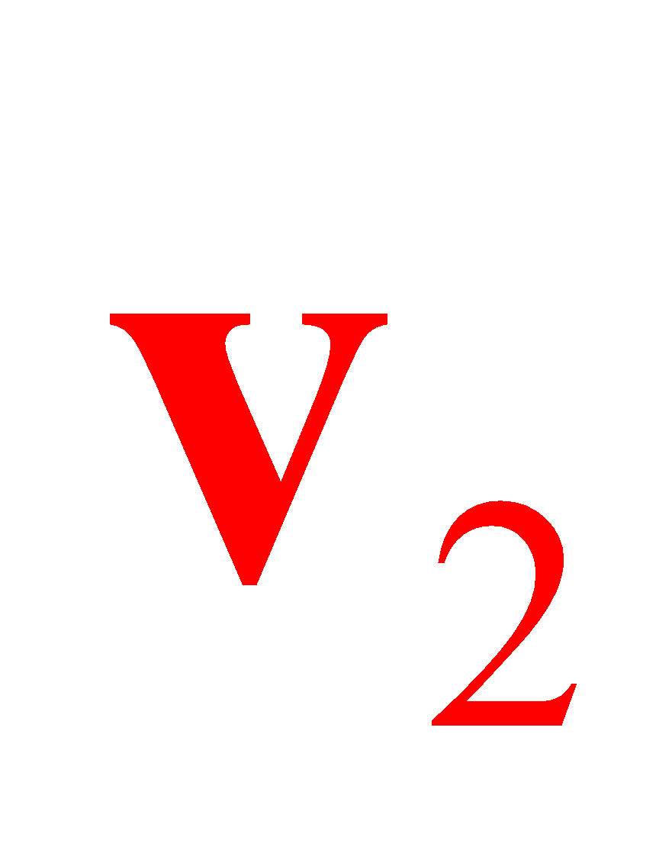


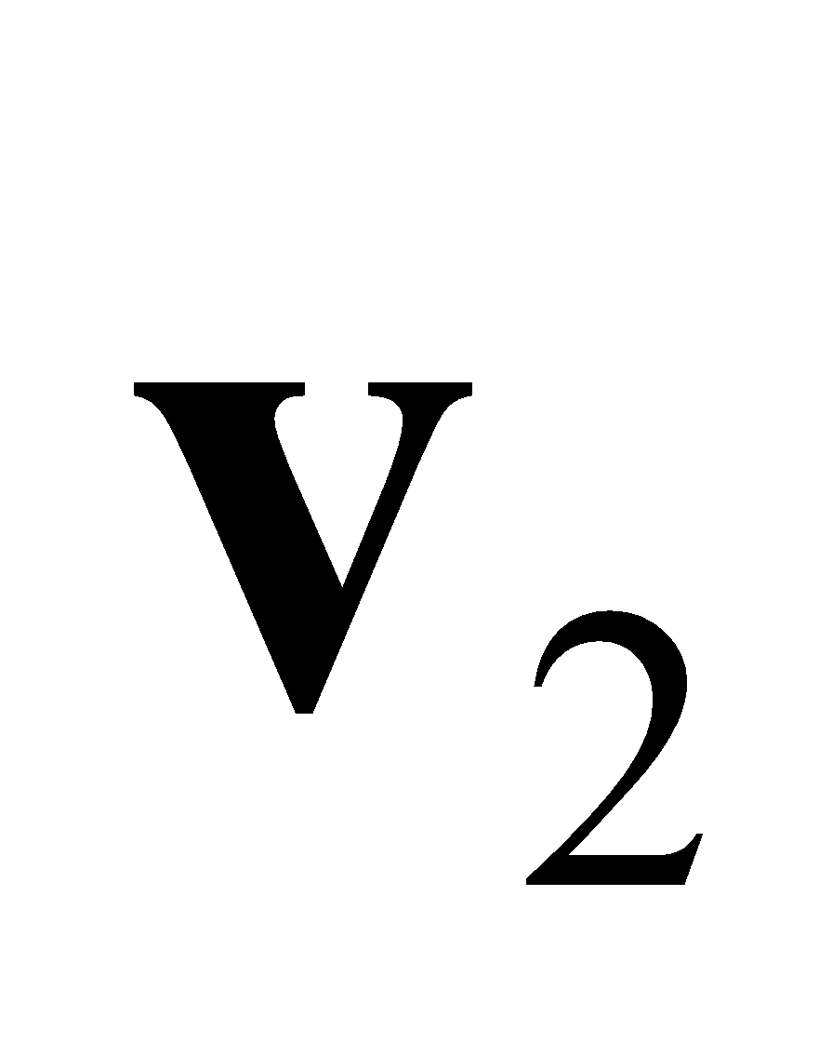
Sutherland-Hodgman Polygon Clipping
out
in
in
in
output:
output:
out
out
output: none
in
out
output:

Slide 30
Sutherland-Hodgman Polygon Clipping
2
2’
3
2”
1’
3’
1

Slide 31
Example
2
2’
3
2”
1’
3’
1
Input | Left Clipper | Right Clipper | Bottom Clipper | Top Clipper
[1,2]: | (in-in)>{2}
[2,3]: | (in-out)>{2’} | [2,2’]:(in-in)>{2’}
[3,1]: | (out-in)>{3’,1} | [2’,3’]:(in-in)>{3’} | [2’,3’]:(in-out)>{2”}
 |  | [3’,1]:(in-in)>{1} | [3’,1]:(out-out)>{}
 |  | [1,2]:(in-in)>{2} | [1,2]:(out-in)>{1’,2} | [2”,1’]:(in-in)>1’}
 |  |  | [2,2’]:(in-in)>{2’} | [1’,2]:(in-in)>{2}
 |  |  |  | [2,2’]:(in-in)>{2’}
 |  |  |  | [2’,2”]:(in-in)>{2”}

Slide 32
Worked Out Example
https://www.youtube.com/watch?v=E27uacJIcwQ

Slide 33
Thank You

